Slide 1
The Bible in
Ethical Decisions
Session 26
Dr. Lewis Winkler • East Asia School of Theology (Singapore) Uploaded by Dr. Rick Griffith • Jordan Evangelical Theological Seminary Files in many languages for free download at BibleStudyDownloads.org

Slide 2
I. Introduction:

Slide 3
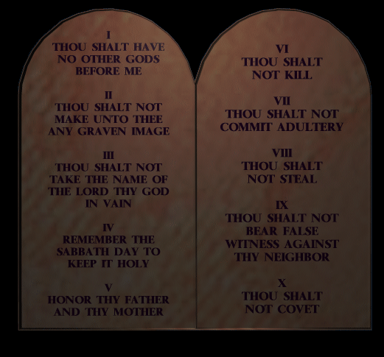
II. The Nature and Authority of Scripture in Ethical Decision-making
The Bible as a Moral Code Book
Definition

Slide 4
II. The Nature and Authority of Scripture in Ethical Decision-making
The Bible as a Moral Code Book
Definition
Evaluation

Slide 5
II. The Nature and Authority of Scripture in Ethical Decision-making
The Bible as a Moral Code Book
Definition
Evaluation
The Bible as a Helpful Moral Resource Alongside Many Other Resources
Definition

Slide 6
II. The Nature and Authority of Scripture in Ethical Decision-making
The Bible as a Moral Code Book
Definition
Evaluation
The Bible as a Helpful Moral Resource Alongside Many Other Resources
Definition
Evaluation

Slide 7
II. The Nature and Authority of Scripture in Ethical Decision-making
The Bible as the Inspired Word of God
Definition

Slide 8
II. The Nature and Authority of Scripture in Ethical Decision-making
The Bible as the Inspired Word of God
Definition
Evaluation

Slide 9
III. Hermeneutical Issues in Ethical Decision-making
Many contemporary ethical issues are not directly addressed by scripture.

Slide 10
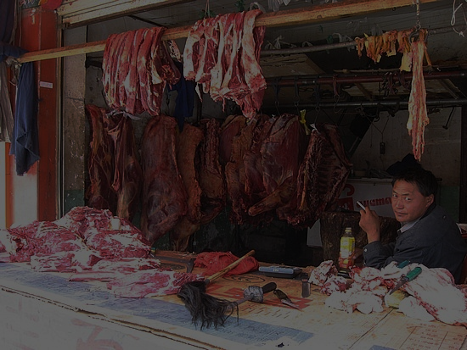
III. Hermeneutical Issues in Ethical Decision-making
Many contemporary ethical issues are not directly addressed by scripture.
Some ethical issues addressed in scripture, while closely related, are not identical to current ethical issues.

Slide 11
III. Hermeneutical Issues in Ethical Decision-making
Issues Surrounding the Relationship between the Old and New Testaments

Slide 12
III. Hermeneutical Issues in Ethical Decision-making
Issues Surrounding the Relationship between the Old and New Testaments
The Relationship between the Uniqueness of the Situation and the Universal Character of the Ethical Demands

Slide 13
III. Hermeneutical Issues in Ethical Decision-making
Issues Surrounding the Relationship between the Old and New Testaments
The Relationship between the Uniqueness of the Situation and the Universal Character of the Ethical Demands
Handling Issues Involving Multiple Biblical Principles and Paradigms

Slide 14
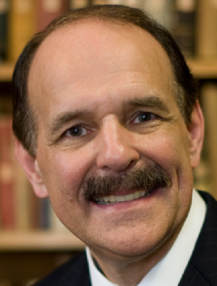
Difficult cases must be decided within the broad contours of biblical teaching, but sometimes we may have to appeal to the leading of the Holy Spirit and the discernment of the Christian community. This does not mean that one moral response is as good as another, but it does mean we must use humility in the decision-making process. We need to make clear what is at stake biblically and theologically and then seek the moral good through the Spirit’s leading, sanctified reasoning, and the collective wisdom of the church, both past and present. Dennis P. Hollinger, Choosing the Good, 162

Slide 15
IV. Forms of Ethical Guidance in the Bible
Specific Commands in Specific Contexts

Slide 16
IV. Forms of Ethical Guidance in the Bible
Specific Commands in Specific Contexts
General Divine Commands

Slide 17
IV. Forms of Ethical Guidance in the Bible
Specific Commands in Specific Contexts
General Divine Commands
Principles

Slide 18
IV. Forms of Ethical Guidance in the Bible
Specific Commands in Specific Contexts
General Divine Commands
Principles
General Paradigms and Implied Ethical Directions

Slide 19
IV. Forms of Ethical Guidance in the Bible
Specific Commands in Specific Contexts
General Divine Commands
Principles
General Paradigms and Implied Ethical Directions
Moral Examples and Stories

Slide 20
V. Conclusion

Slide 21
Black

Slide 22
Worldview link at BibleStudyDownloads.org
Get this presentation for free!
Notes:
WV (Worldviews)

